Slide 1
Community Wildfire Protection Plan
Decision Support Information:
The CWPP will be evaluating conditions through -
West Wide Wildfire Risk Assessment
Local Knowledge
Any additional local data currently available

Slide 2
West Wide Wildfire Risk Assessment 17 State Risk Assessment
Alaska and Hawaii not shown
Notes:
Geographic Areas broken out at the National Level
Western Regional Area - seventeen states including Alaska and Hawaii
Best Available data gathered as consistent as possible across states

Slide 3
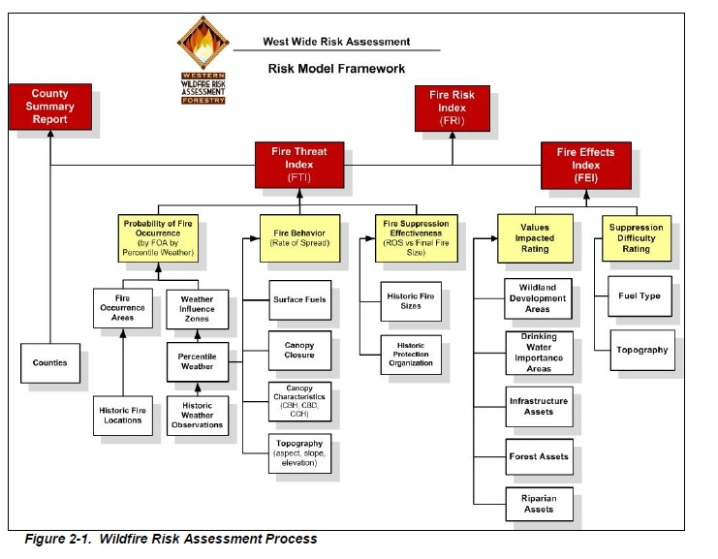
West Wide Wildfire Assessment
What is it?
Notes:
Risk Analysis Tool using best available data.
Multiple layers of data information with mathematical calculations in background

Slide 4
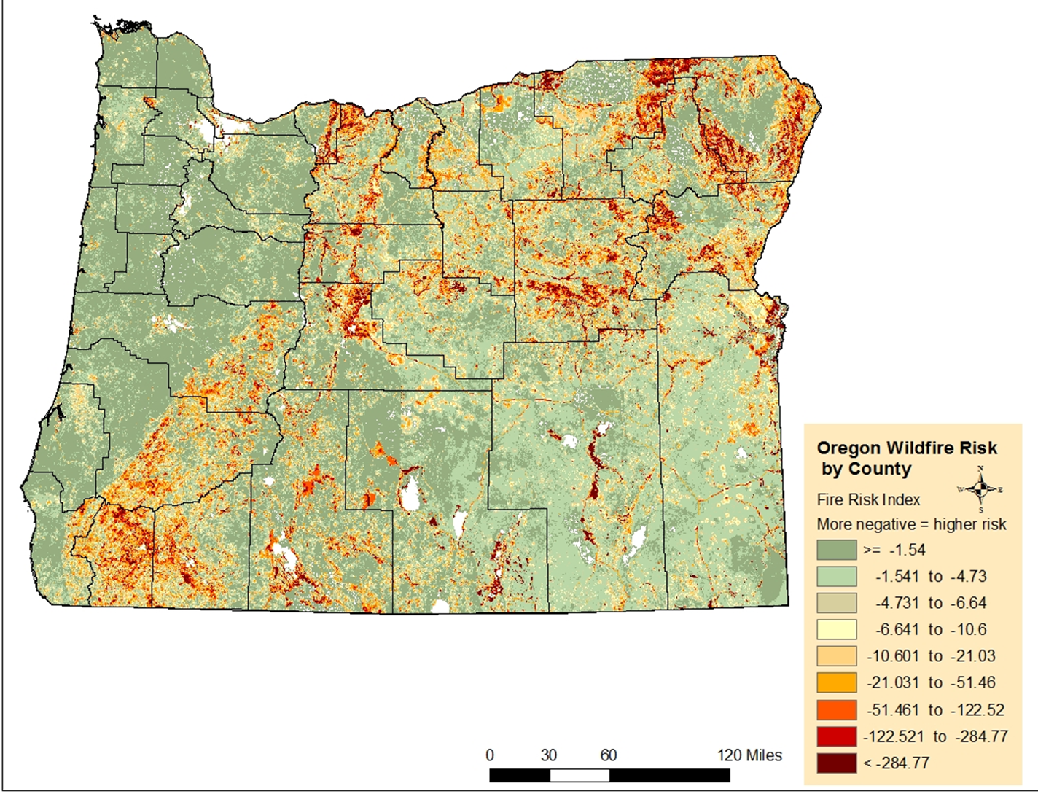

Slide 5
Union County Wildfire Risk with WUIs

Slide 7
Local Knowledge
Allows protection Plans to be based on needs of those involved
Healthy Forest Restoration Act requires collaboration, prioritization (fuels), and treatment to minimize structure ignitability.
Can help influence how federal funds for projects on non-federal WUI lands may be obtained.
Validate data base information
Innovative ideas and approaches for local area
Notes:
Measures to reduce structure ignitions.

Slide 8
Cohesive Wildfire Strategy
Resources such as equipment and personnel improve the ability to respond to wildfire.
Also increases consideration for improved coordination, communication, and training which are important components of intergovernmental preparedness and should be included regional or national strategy.

Slide 11
Information Use
Be Competitive in grant programs designed to providing support to states, counties, local fire departments, and communities to prepare for and recover from wildfire.
A means to help inform funding and prioritization processes at the local, regional, and national levels including FS priorities for broad-scale fuels management.
Collaborative based decision provide more opportunities for greater efficiency and effectiveness.
Notes:
Department of Homeland Security through FEMA oversee grant programs

Slide 13
e. CWPP Decision Support Information - Jenny
• Supporting data, local knowledge, etc.
3. Highlight West Wide Assessment Role vs. local knowledge role - Jenny
4. Brief display of County information mapping, individual WUIs, Rural - fire occurrence – Jenny

