Slide 1
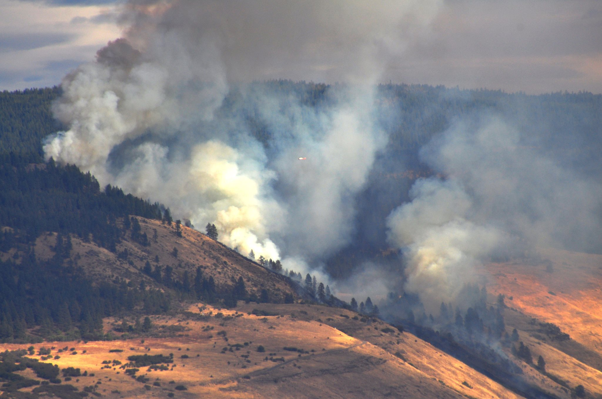
CWPP REVISION
ARE YOU PREPARED IF A WILDFIRE THREATENS YOUR PROPERTY?
TOGETHER WE CAN MAKE A DIFFERENCE!
Union County Community Wildfire Protection Plan
If YES, we would like your help!
If NO, we can help you prepare!
Meet with us about: Defensible Space, County Fire Risk, Multi-Fire Agency Support, Working Together for a Common Goal.
Public Meetings Schedule:
Elgin - 6 PM at the Fire Station, Thursday April 30th
Union -6 PM at the Union Fire Station, Wednesday May 6th

Slide 2
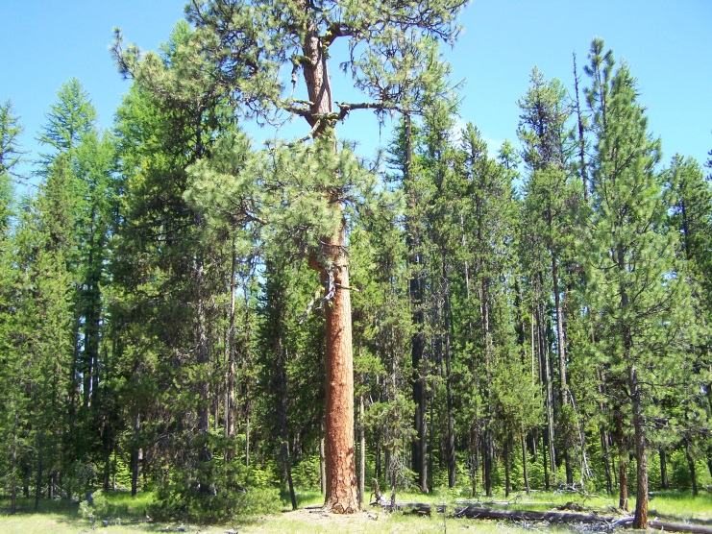
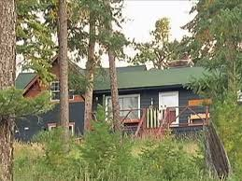
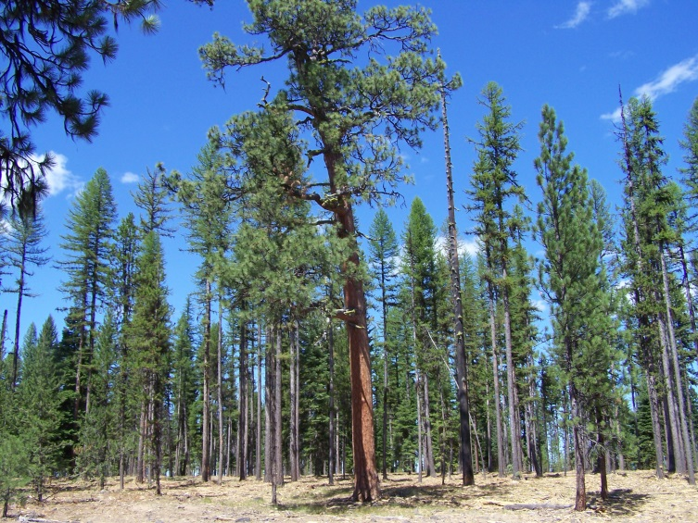
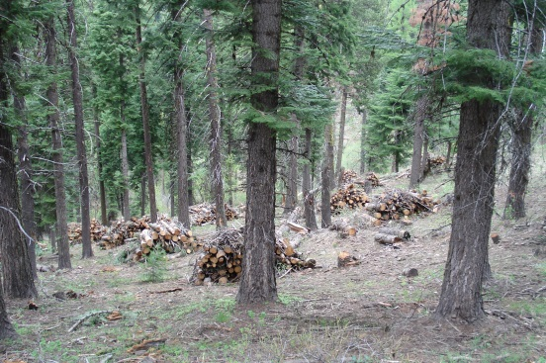
Is your property Prepared? Let us help you increase your chances for a successful outcome!
Before
After
Ready-Set-Go: www.wildlandfiresg.org
Firewise: www.firewise.org
And http://www.firewise.org/wildfire-preparedness/firewise-toolkit.aspx
Contact: Joe Hessel – ODF – 541 963 - 3168
JB Brock – Union County Emerg. Service – 541 963 – 1009
Larry Woolridge – La Grande Rural Fire – 541 963 - 6895
Union County Emergency Services Oregon Dept. Forestry (ODF)
Union County Rural Fire Departments US Forest Service
Bureau of Land Management La Grande Rural Fire Dept.

